Slide 1
Feature Recognition as a consultant based on Airbnb data
Presented by:
Romeo
Sarthak
Zahra

Slide 2
Business Scope:
Assuming ourselves as an Airbnb consultant, we are preparing the list of features in order to maximize the profit for hosts. Also, we are preparing models to advise them the type of houses in which customers are more interested. If any hosts possess more than one houses listed on Airbnb, we're expecting to give them insights on which house generates more profit for them.

Slide 3
Outline
About our dataset
Data cleaning
Advice on how to benefit from your Airbnb experience as a host
a) 1- Guest Preference and seasonality
2 - Price and seasonality
b) Price and relationship with other variables in our dataset
Conclusion

Slide 4
About our dataset
Dataset that is used in this project is 'The Berlin Airbnb data'.
Despite 6 tables in the dataset, we've used 3 tables as per the information. We're trying to deduce the tables as follows:
Calendar_summary :(8231480, 9)
Listings: (22552, 16)
Listings_summary: (22552, 96)

Slide 5
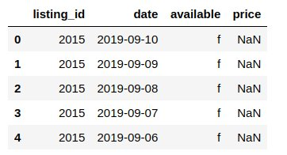
Calendar_summary table Deeper insights in Data
About our dataset

Slide 6
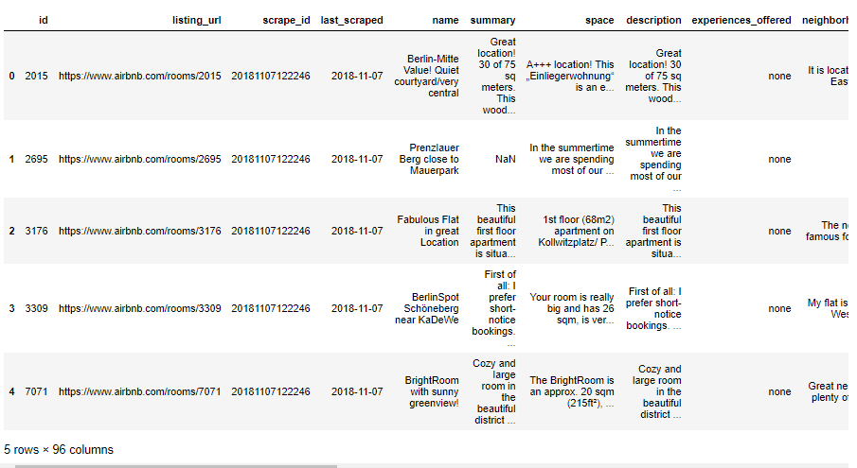
Listings_summary table
About our dataset
Includes different features of house along with price

Slide 7
II. Data Cleaning
We chose following as our main tables:
The Calendar_summary and
Listings_summary
We reduce the columns in Listings_summary to what we needed in our analysis
We've selected the price lower than 300 based on outliers detection analysis.

Slide 8
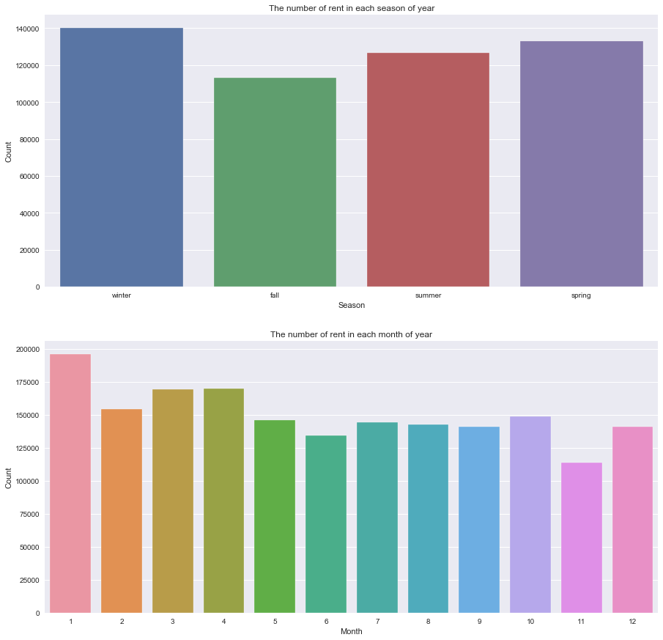
By checking seasonality, we found that the fall has the lowest interest for guests
III a) 1 - Guest Preference and seasonality
In accordance to month, January is the most preferred month by Airbnb customers.

Slide 9
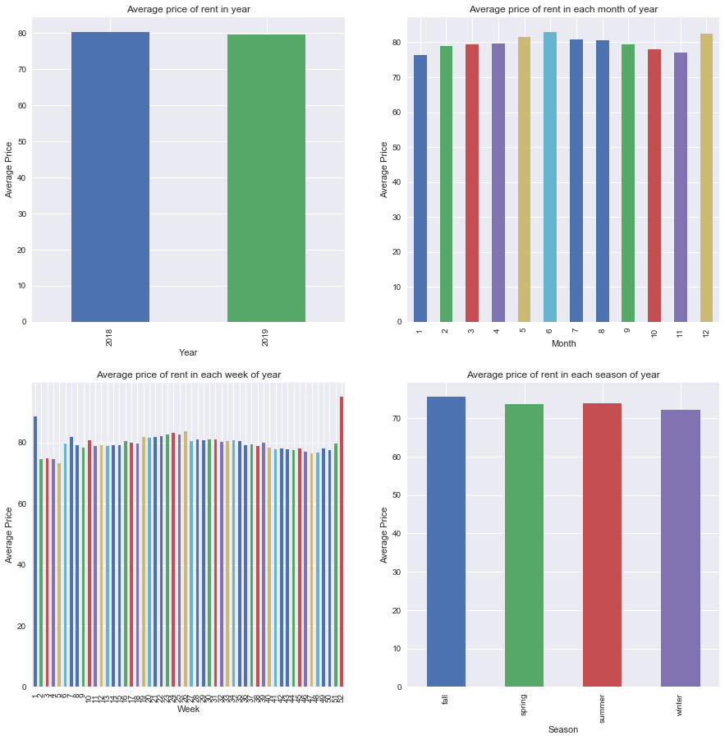
Seasonality and behavior of data during different time of the year, month, week based on average price. all season.
III a) 2- Price and seasonality
It shows December and July have the highest average price in months.
Fall has the highest average price in all season.

Slide 10
Gold List:
III b) Price and relationship with other variables in our dataset
1. December and July in months
2. fall and summer as season

Slide 11
Gold List:
III b) Price and relationship with other variables in our dataset
Seasonality
Accommodates​​
Bedrooms​​
Area (Square feet​)​
Guest included​​
Neighborhood

Slide 12
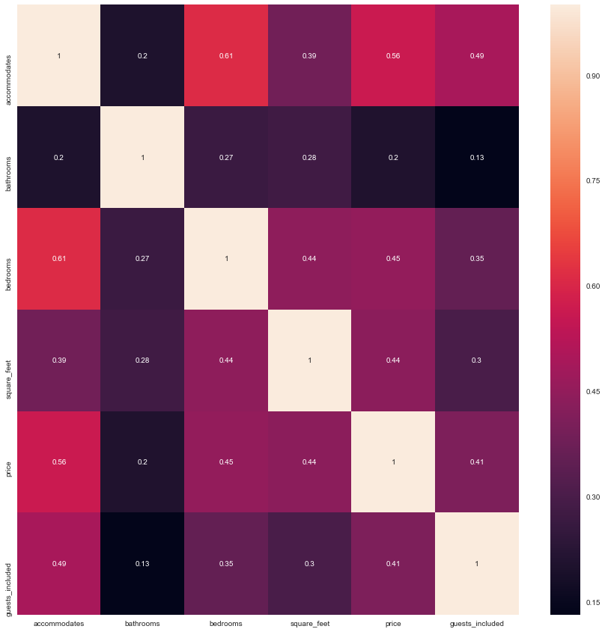
III a) Price and relationship with other variables in our dataset
From this heatmap, the highest correlations to price are:
Accomodates
Bedrooms
Square feet
Guests included

Slide 13
Gold List:
III b) Price and relationship with other variables in our dataset
Accommodates​​
Bedrooms​​
Area (Square feet​)​
Guest included​​
Neighborhood
Seasonality

Slide 14
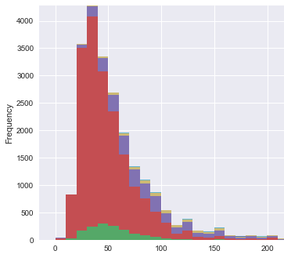
Distribution of bedrooms
III b) Price and relationship with other variables in our dataset
It shows the most interesting and common rooms are with 0 and 1 bedrooms.

Slide 15
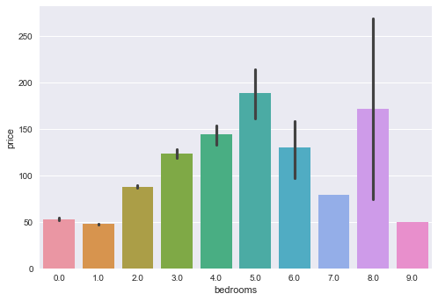
Relation of price with the number of rooms
III b) Price and relationship with other variables in our dataset
The number of rooms has direct effect on price till 5 bedrooms and has and after that we can see the fluctuation price for upper than 5.

Slide 16
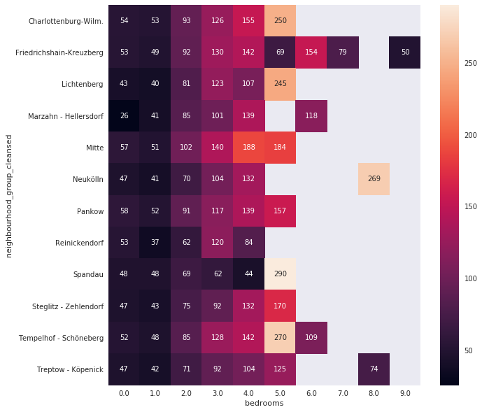
Average price by number of bedrooms in each neighborhood area
III b) Price and relationship with other variables in our dataset
We can see again the rooms with 5 bedrooms has the highest average price in this plot.

Slide 17
Gold List:
III b) Price and relationship with other variables in our dataset
Accommodates​​
Bedrooms​​
Area (Square feet​)​
Guest included​​
Neighborhood
Seasonality

Slide 18
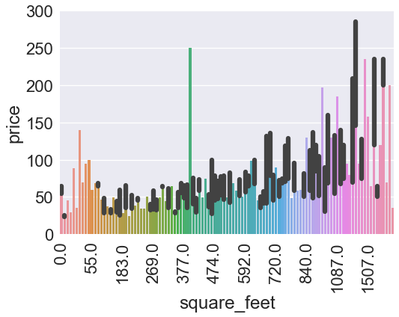
The plot support what heatmap claimed before and the price going up if square feet increase
III b) Price and relationship with other variables in our dataset

Slide 19
Gold List:
III b) Price and relationship with other variables in our dataset
Accommodates​​
Bedrooms​​
Area (Square feet​)​
Guest included​​
Neighborhood
Seasonality

Slide 20
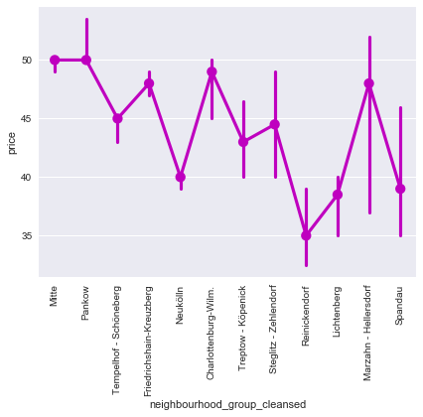
Behaviour of price in Neighborhood
III b) Price and relationship with other variables in our dataset
As we can see in the figure:
Pankow and Mitte are more consistent neighborhood with relatively greater median than other neighborhoods.
Marzahn-Hellersdorf also has greater price input, however, it also has a large fraction below the median price.

Slide 21
Gold List:
III b) Price and relationship with other variables in our dataset
Accommodates​​
Bedrooms​​
Area (Square feet​)​
Guest included​​
Neighborhood
Seasonality

Slide 22
More about factors Airbnb hosts should consider
III c) Lessons learned from our data
We dwelled into details in the dataset and found out about the features that can be added in the house to make more profit.
We are going to focus on 'Amenities' columns in Listings_summary table.

Slide 23
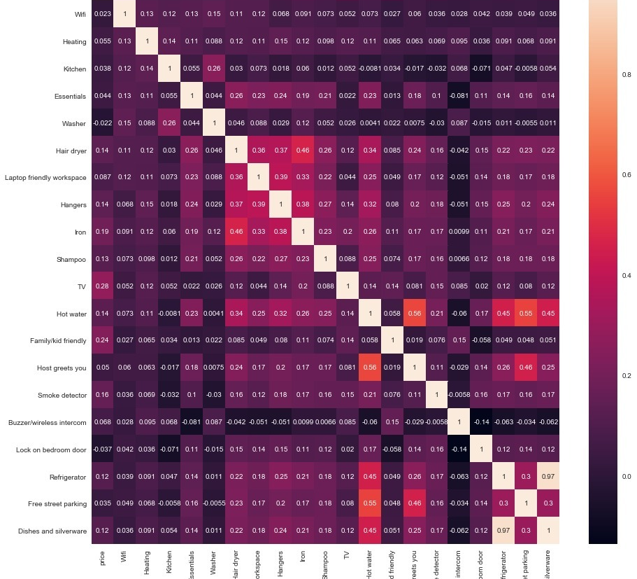
Correlation between price and amenities features
III c) Lessons learned from our data
Most relevant:
1- TV
2- Family/kid friendly
3- Smoke detector
… and so on

Slide 24
The most relevant amenities with price:
III c) Lessons learned from our data
1- TV
2- Family/kid friendly
3- Smoke detector
4-Iron
5- hair dryer
6- Hangers
7- Hot water
8- Shampoo
9- Refrigerator
10- Dishes and silverware

Slide 25
Final Golden List:
III c) Lessons learned from our data
Amenities:
1- TV
2- Family/kid friendly
3- Smoke detector
4-Iron
5- hair dryer
6- Hangers
7- Hot water
8- Shampoo
9- Refrigerator
10- Dishes and silverware
Best time to rent your house:
1- December and July in months
2- fall and summer as season
House feature:
1- Accommodates
2- Bedrooms
3- Square feet
4- Guest included
5- Neighborhood

Slide 26
Conclusion
Key features for maximum profit are Accommodates, Bedrooms, Bathrooms, Area of the house and so on.
Apart from these features, the host can focus on some amenities as TV, kid-friendly environment, Smoke detector, iron and so on to maximize profit.
Keeping these features into account, hosts can turn his Airbnb business stand out among the crowd.

Slide 27
Questions?

Slide 28
Thank you!

